Slide 1

STORE, SEARCH, ANALYZE

Slide 2
AGENDA
Introduction
Downloading and running an Elasticsearch node + Kibana
Basic concepts
Basic configuration
Adding, updating, retrieving and deleting data (CRUD)
Query syntax, basic search queries
Basic text analysis theory and practice
Mappings overview & query/filtering consequences
Searching one more time
Analytical aggregations
JAVA clients
Advanced subjects
Where to find more resources
DOCKIND3 Aspect

Slide 4
INTRODUCTION
Elasticsearch is a highly scalable open-source full-text search and analytics engine (build on top of the Apache Lucene). It allows you to store, search, and analyze big volumes of data quickly and in near real time. It is generally used as the underlying engine/technology that powers applications that have complex search features and requirements.
No individual part of Elasticsearch is new or revolutionary. Full-text search has been done before, as have analytics systems and distributed databases. The revolution is the combination of these individually useful parts into a single, coherent, real-time application. It has a low barrier to entry for the new user, but can keep pace with you as your skills and needs grow.

Slide 5
INTRODUCTION
However, Elasticsearch is much more than just Lucene and much more than “just” full-text search. It can also be described as follows:
A distributed real-time document store where every field is indexed and searchable
A distributed search engine with real-time analytics
Capable of scaling to hundreds of servers and petabytes of structured and unstructured data
And it packages up all this functionality into a standalone server that your application can talk to via a simple RESTful API, using a web client from your favorite programming language, or even from the command line.
Stack Overflow combines full-text search with geolocation queries and uses more-like-this to find related questions and answers.
GitHub uses Elasticsearch to query 130 billion lines of code.
Wikipedia uses Elasticsearch to provide full-text search with highlighted search snippets, and search-as-you-type and did-you-mean suggestions.
Links:
https://www.elastic.co/guide/en/elasticsearch/reference/current/getting-started.html
https://www.elastic.co/guide/en/elasticsearch/guide/current/getting-started.html

Slide 6
BASIC CONCEPTS

Slide 7
CLUSTER & NODE
Cluster
A cluster is a collection of one or more nodes (servers) that together holds your entire data and provides federated indexing and search capabilities across all nodes. A cluster is identified by a unique name which by default is "elasticsearch". This name is important because a node can only be part of a cluster if the node is set up to join the cluster by its name.
Node
A node is a single server that is part of your cluster, stores your data, and participates in the cluster’s indexing and search capabilities. Just like a cluster, a node is identified by a name which by default is a random Marvel character name that is assigned to the node at startup. You can define any node name you want if you do not want the default. This name is important for administration purposes where you want to identify which servers in your network correspond to which nodes in your Elasticsearch cluster.

Slide 8
INDEX
Index (database in relational world)
An index is a collection of documents that have somewhat similar characteristics (index contains types). For example, you can have an index for customer data, another index for a product catalog, and yet another index for order data. An index is identified by a name (that must be all lowercase) and this name is used to refer to the index when performing indexing, search, update, and delete operations against the documents in it.

Slide 9
INDEX vs INDEX vs INDEX
Index (noun)
As explained previously, an index is like a database in a traditional relational database. It is the place to store related documents. The plural of index is indices or indexes.
Index (verb, to index)
To index a document is to store a document in an index (noun) so that it can be retrieved and queried. It is much like the INSERT keyword in SQL except that, if the document already exists, the new document would replace the old.
Inverted index
Relational databases add an index, such as a B-tree index, to specific columns in order to improve the speed of data retrieval. Elasticsearch and Lucene use a structure called an inverted index for exactly the same purpose.
By default, every field in a document is indexed (has an inverted index) and thus is searchable. A field without an inverted index is not searchable. We discuss inverted indexes in more detail in Inverted Index.

Slide 10
TYPE
Type (table in relational world)
Within an index, you can define one or more types. A type is a logical category/partition of your index whose semantics is completely up to you. In general, a type is defined for documents that have a set of common fields. For example, let’s assume you run a blogging platform and store all your data in a single index. In this index, you may define a type for user data, another type for blog data, and yet another type for comments data.

Slide 11
DOCUMENT
Document (row in relational world)
A document is a basic unit of information that can be indexed. For example, you can have a document for a single customer, another document for a single product, and yet another for a single order. This document is expressed in JSON (JavaScript Object Notation) which is an ubiquitous internet data interchange format.
Within an index/type, you can store as many documents as you want. Note that although a document physically resides in an index, a document actually must be indexed/assigned to a type inside an index.
An Elasticsearch cluster/node can contain multiple indices (databases), which in turn contain
multiple types (tables). These types hold multiple documents (rows), and each
document has multiple fields (columns).

Slide 12
Near Realtime (NRT)
Elasticsearch is a near real time search platform. What this means is there is a slight latency (normally one second) from the time you index a document until the time it becomes searchable.

Slide 13
INVERTED INDEX

Slide 14
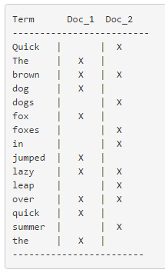
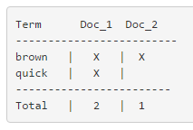
INVERTED INDEX
The quick brown fox jumped over the lazy dog
Quick brown foxes leap over lazy dogs in summer
To create an inverted index, we first split the content field of each document into separate words
(which we call terms, or tokens), create a sorted list of all the unique terms, and then list in which
document each term appears.
Search for „quick brown”

Slide 15
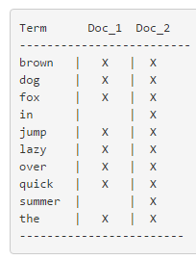
INVERTED INDEX
- Quick can be lowercased to become quick.
- foxes can be stemmed--reduced to its root form—to become fox. Similarly, dogs could be stemmed to dog.
- jumped and leap are synonyms and can be indexed as just the single term jump.
The proces of tokenization and normalization is called analysis.
The indexed text and the query string for full text fields – both are being called to analysis.

Slide 16
ANALYSIS AND ANALYZERS
Analyzers functions:
Character filters
First, the string is passed through any character filters in turn. Their job is to tidy up the string before tokenization. A character filter could be used to strip out HTML, or to convert & characters to the word and.
Tokenizer
Next, the string is tokenized into individual terms by a tokenizer. A simple tokenizer might split the text into terms whenever it encounters whitespace or punctuation.
Token filters
Last, each term is passed through any token filters in turn, which can change terms (for example, lowercasing Quick), remove terms (for example, stopwords such as a, and, the) or add terms (for example, synonyms like jump and leap).
Elasticsearch provides many character filters, tokenizers, and token filters out of the box. These can be combined to create custom analyzers suitable for different purposes.

Slide 17
MAPPINGS – DATA TYPES
JSON type | Field type
Boolean: true or false | boolean
Whole number: 123 | long
Floating point: 123.45 | double
String, valid date: 2014-09-15 | date
String: foo bar | string

Slide 18
RELEVANCE
Term frequency
How often does the term appear in the field? The more often, the more relevant. A field containing five mentions of the same term is more likely to be relevant than a field containing just one mention.
Inverse document frequency
How often does each term appear in the index? The more often, the less relevant. Terms that appear in many documents have a lower weight than more-uncommon terms.
Field-length norm
How long is the field? The longer it is, the less likely it is that words in the field will be relevant. A term appearing in a short title field carries more weight than the same term appearing in a long content field.

Slide 19
SHARDS AND REPLICAS

Slide 20
ADVANCED: SHARED AND REPLICAS
A shard is a low-level worker unit that holds just a slice of all the data in the index (containers for data). For now it is enough to know that a shard is a single instance of Lucene, and is a complete search engine in its own right. Documents are stored and indexed in shards, but our applications don’t talk to them directly. Instead, they talk to an index.
Sharding is important for two primary reasons:
It allows you to horizontally split/scale your content volume
It allows you to distribute and parallelize operations across shards (potentially on multiple nodes) thus increasing performance/throughput
As cluster grows or shrinks, Elasticsearch will automatically migrate shards between nodes so that the cluster remains balanced. The number of primary shards in an index is fixed at the time that an index is created, but the number of replica shards can be changed at any time.

Slide 21
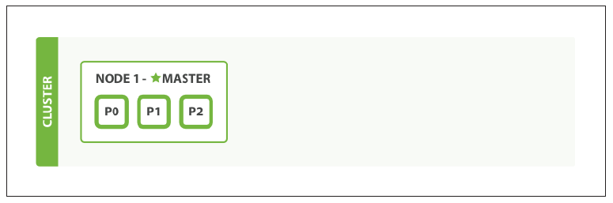
PUT /document
{
"settings" : {
"number_of_shards" : 3,
"number_of_replicas" : 1
}
}
SINGLE NODE WITH INDEX WITH 3 PRIMARY SHARDS

Slide 22
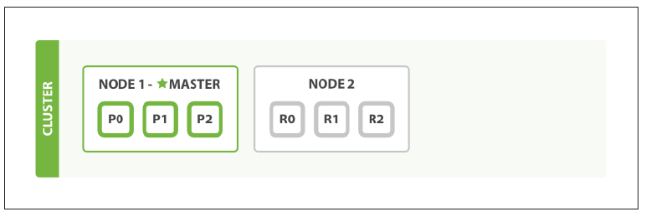
ADDED SECOND NODE

Slide 23
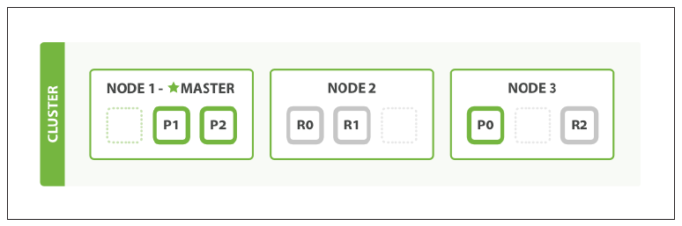
ADDED THIRD NODE

Slide 24
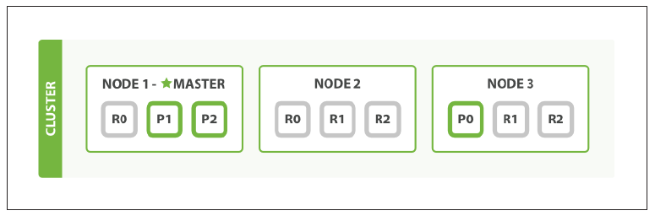
PUT /document/_settings
{
"number_of_replicas" : 2
}
TWO REPLICAS

Slide 25
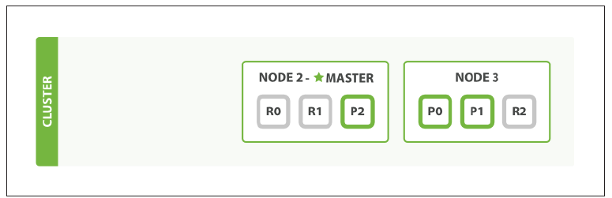
FAILURE FIRST NODE

Slide 26
PARENT-CHILD RELATIONSHIP
The parent-child relationship is similar in nature to the nested model: both allow you to associate one entity with another. The difference is that with parent-child they are completely separate documents.
The parent-child functionality allows you to associate one document type with another, in a one-to-many relationship—one parent to many children. The advantages that parent-child has over nested objects are as follows:
The parent document can be updated without reindexing the children.
Child documents can be added, changed, or deleted without affecting either the parent or other children. This is especially useful when child documents are large in number and need to be added or changed frequently.
Child documents can be returned as the results of a search request.
Elasticsearch maintains a map of which parents are associated with which children. It is thanks to this map that query-time joins are fast, but it does place a limitation on the parent-child relationship: the parent document and all of its children must live on the same shard.
The parent-child ID maps are stored in Doc Values, which allows them to execute quickly when fully hot in memory, but scalable enough to spill to disk when the map is very large.

Slide 27
LINKS
Download Elasticsearch & Kibana: https://www.elastic.co/downloads
Installing Sense: https://www.elastic.co/guide/en/sense/current/installing.html
Materials: https://github.com/pnowy/elastic
Resources: Elasticsearch – the definitive guide & Elasticsearch documentation

